Slide 1
EECT 112 Digital Fundamentals Basic Stamp- 7 Segment Hex Counter
BY Zach AndersoN
Karla CAMPOS
Spring Semester 5-15-15

Slide 2
Basic Stamp- 7 Segment Hex Counter Table of Contents
Why we chose this project
Project requirements
Research and challenges
Stamp code
Materials
Visuals

Slide 3
Basic Stamp- 7 Segment Hex Counter Why did we chose this project?
We chose this project for two main reasons:
The main reason is because it seemed the most interesting to us.
It also happened to be the project that would require the least amount of time, and with both of us being full time students, it worked out very nicely.

Slide 4
Basic Stamp- 7 Segment Hex Counter Project Requirements.
1
Count from zero to F then backwards from F to zero.
The start of the program must loop around the outside of the display five times in approx two seconds, then start at zero and count up
2
At the max count going up on F, must flash the "F" 1 second ON 1 second OFF twice before starting to count down.
3
At the min count counting down, must flash the "0" 1 second ON 1 second OFF, twice, then repeat from the beginning.

Slide 5
Basic Stamp- 7 Segment Hex Counter Research & Challenges
Research
We researched the datasheet for the 7 segment display MAN748.
We used information we learned from previous labs.
Challenges
We encountered several challenges through the process of completing this project.
The main challenges we faced were pertaining to the code in the Stampw program.
Our first several times running our system, several parts of the counter were not lighting up. But after checking our code, we were able to sort out the mistakes and get the counter working perfectly.

Slide 6
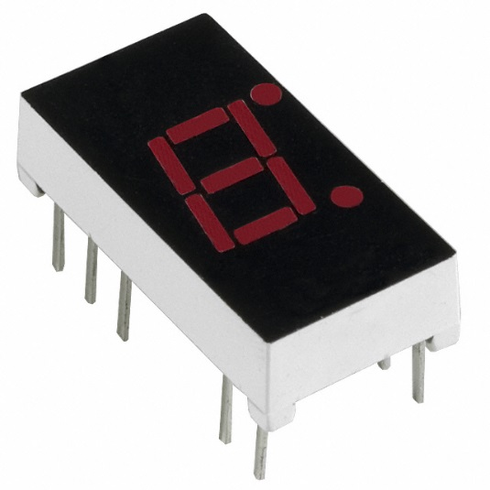
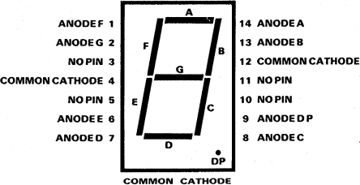
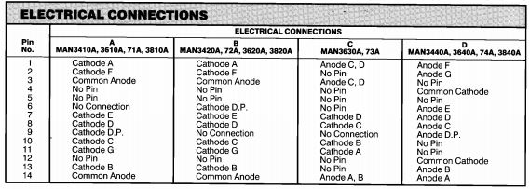
Basic Stamp- 7 Segment Hex Counter 7 Segment Display Datasheet (MAN74A)

Slide 7
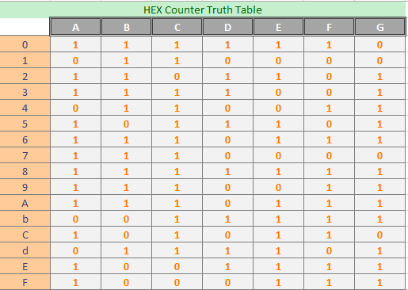
Basic Stamp- 7 Segment Hex Counter Hex Counter Truth Table

Slide 8
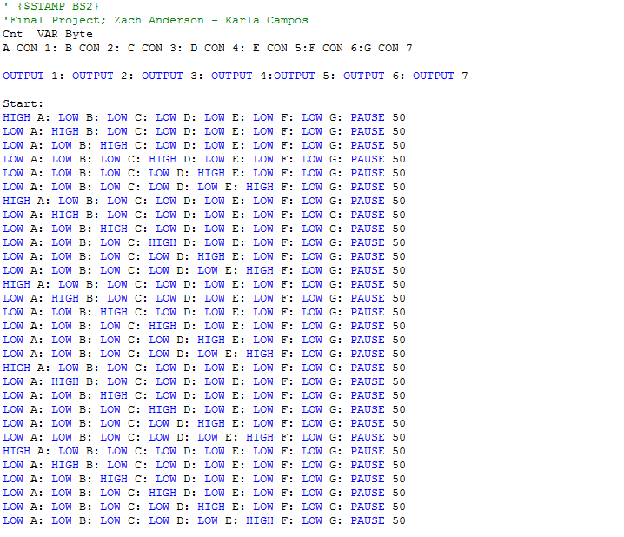
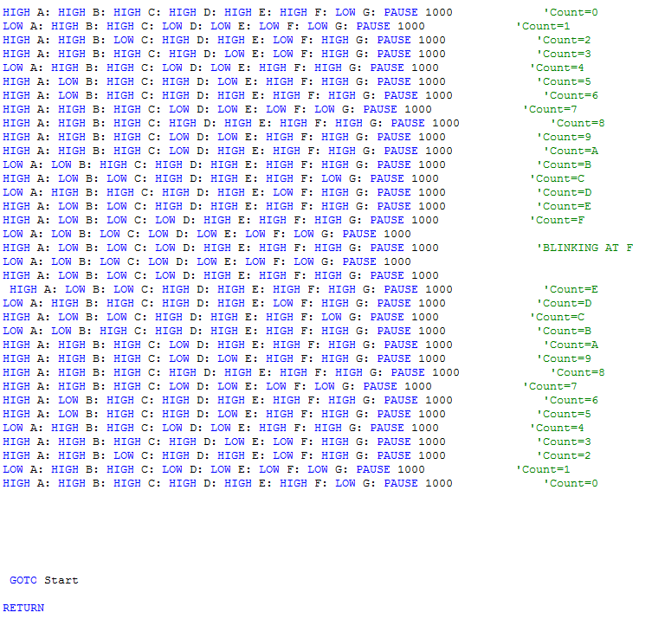
Basic Stamp- 7 Segment Hex Counter Stampw Software (BASIC Stamp code)

Slide 9
Basic Stamp- 7 Segment Hex Counter Materials Used
Materials used:
1 x 100 ohm resistor
Jumper Wires
1 x common cathode hex counter
Miscellaneous wires
Basic Stamp Breadboard
Stampw computer program
Serial Cable
Power Supply

Slide 10
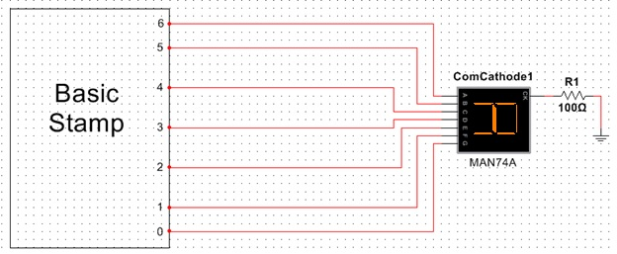
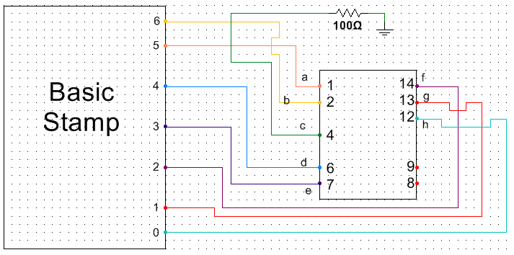
Basic Stamp- 7 Segment Hex Counter Multisim Schematics

Slide 11
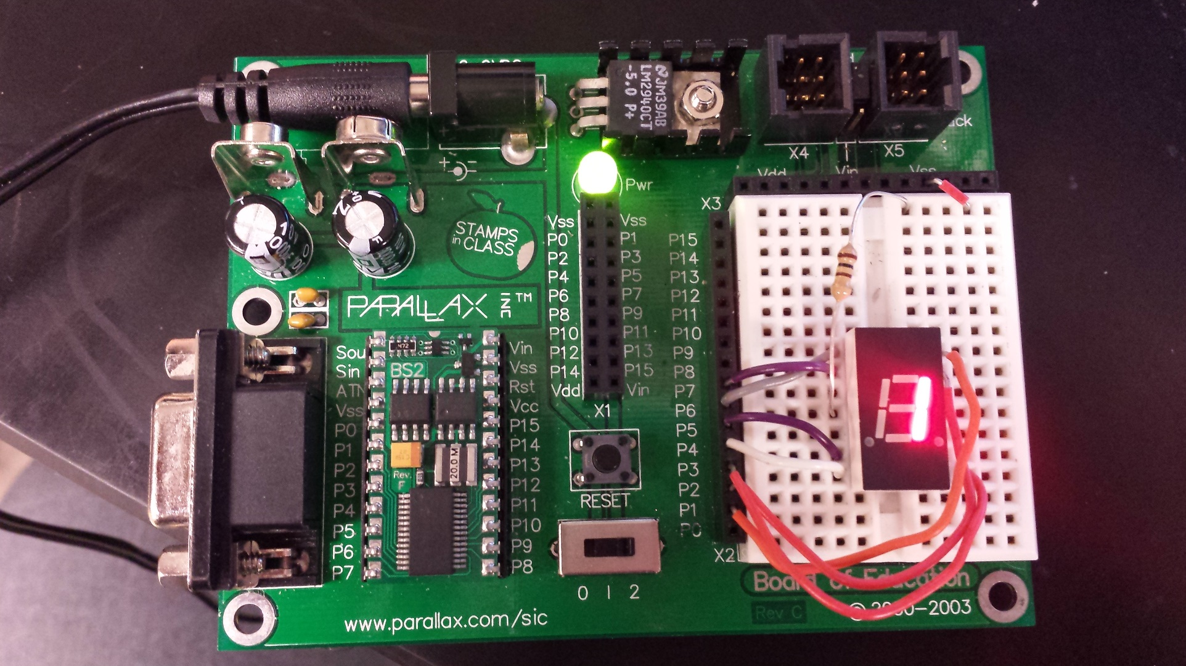
Basic Stamp- 7 Segment Hex Counter Materials and Parts
Basic Stamp Board
100 Ohm Resistor
MAN74A 7
Segment Display
Breadboard
Wires

Slide 12
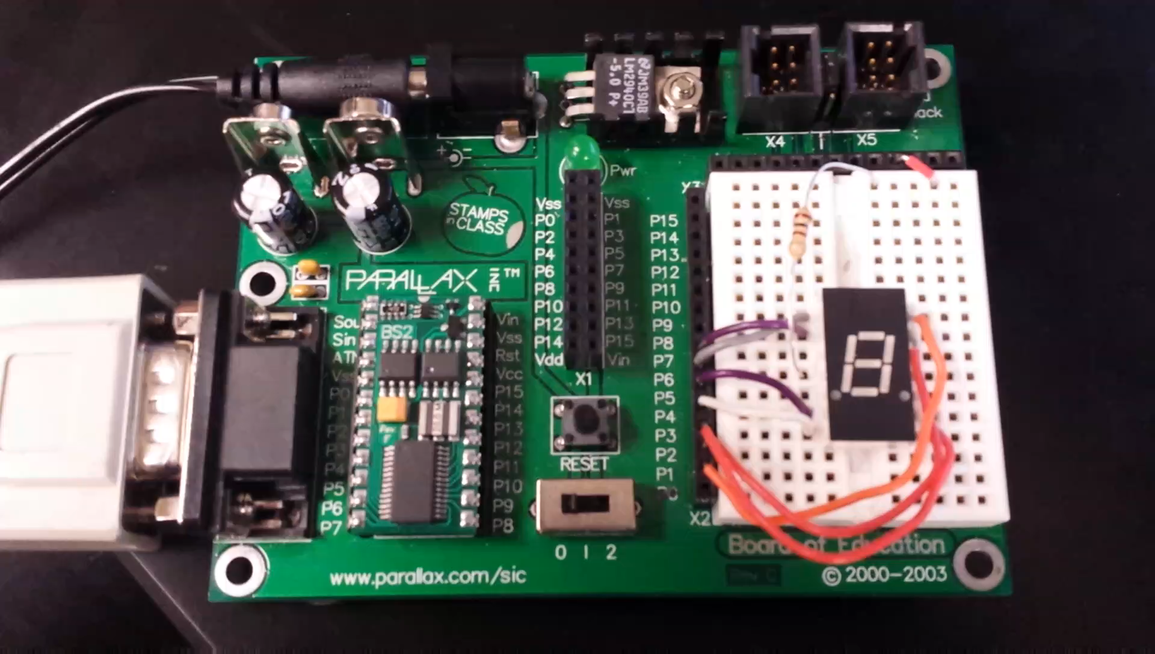
Basic Stamp- 7 Segment Hex Counter Final Project Video Clip

Slide 13
The End
Questions?
Comments?
Concerns?
Compliments?

